Slide 1

Azure App integrated with Google Drive
Features
Expose Documents from Google Drive
Allow document uploads to Google Drive
Expose data Google Sheets
Conduct a Poll
Integrated with Google Authentication
Log user activity
Works on mobile/desktop
What you will need
Azure Web App (Free Tier is ok)
Docker Hub (Private repository is preferred)
Git hub (download the source code)
Docker Desktop
IDE (Visual Studio Code)

Slide 2
Setup your gmail account
First step is to setup your gmail account
You will get 15GB free access of storage

Slide 3
Step 1: Source Code and Master Sheet
Download the Microsoft Excel Worksheet attached and save it as an Excel File
Copy the Excel File into Google Drive (https://drive.google.com).
Open the Sheet in Google Sheets and save it as a Google sheet. Make sure to note the name of the sheet. This will be needed later in Step10. E.g. My sheet’s name is SocietyAppMain
Download the source code https://github.com/mahendrachandrasekhar/SocietyApp.git
DOWNLOAD EXCEL SHEET HERE

Slide 4
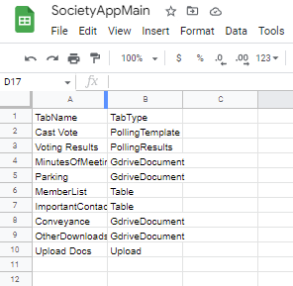
Step 2: Setup the Master Sheet - Tabs
In the “Tabs” Sheet enter the different tabs you need in you application
There are 5 types of Features Supported in this app
GdriveDocument: This will display all the documents in a given folder (specified in the TabName) that have been given access to the service account. We will see the setup of the service account later.
Table: This displays the contents of the Sheet mentioned in the “TabName”. The data is displayed as is (As a pandas dataframe)
Upload: This allows users to upload files in the folder that is specified in the “CurrentUploadFolder” Sheet. There can be just one tab of type “Upload”. See next screen for screenshot and details
PollingTemplate: This is used to setup a tab that will allow you to setup a Voting Ballot for use in your AGMs. The Sheet containing the Resolutions to vote on is picked up from the sheet name mentioned in the “CurrentPoll” sheet.
PollingResults: This is used to display the Polling Questions and the results.

Slide 5
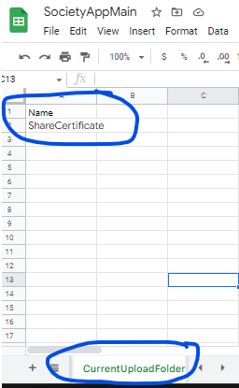
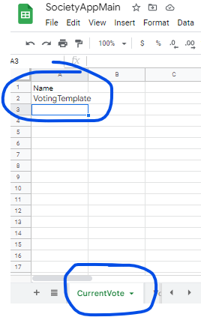
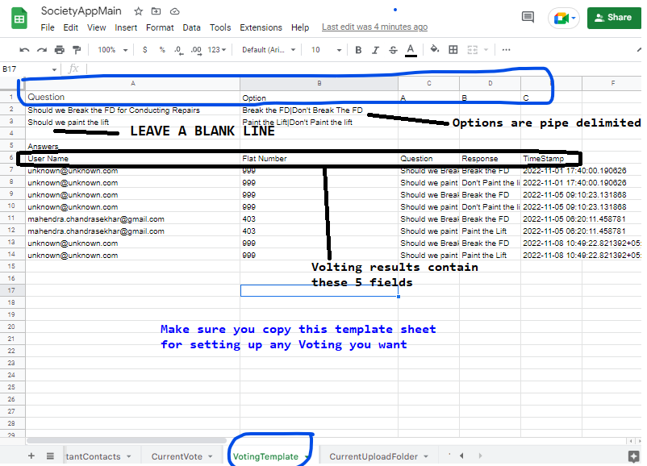
Master Sheet: Tab Information
Here the Upload Tab will upload files in the “ShareCertificate” folder (folder in Google Drive).
Here the Current Ballot will be based on the questions in the VotingTemplate Sheet in this gsheet. (It should be in the same workbook)
Setting up the Voting Sheet

Slide 6
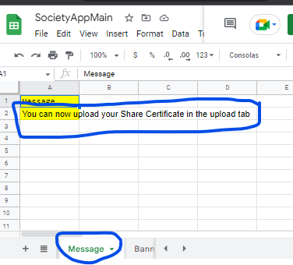
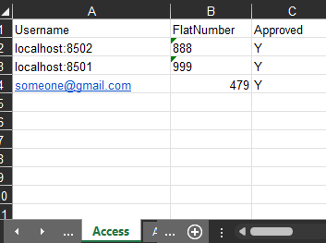
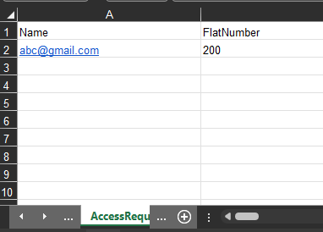
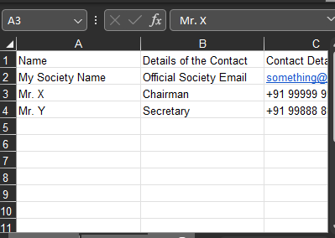
Master Sheet: Tab Information
Grant people access by adding their email here
If anyone requests access you will see it in the “AccessRequest” sheet
Add them to the “Access” tab if you want to give access
Setting up a sheet to display a table (TabType = Table)
It can be any sheet data you want to display
Setup the message you want to display on every tab (Important Notice)

Slide 7
Step 3: Setup Local Folder
Create a folder in your local desktop/laptop
Create a subfolder called .config
Create a subfolder called .banner

Slide 8
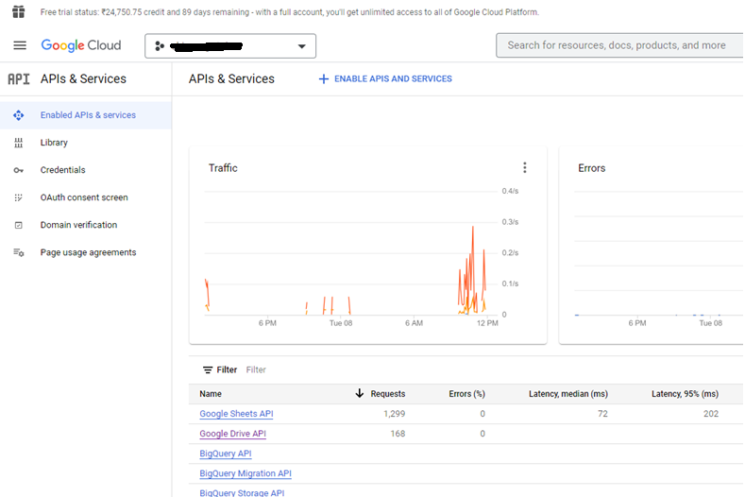
Step 4: Setup Google Cloud APIs
Go to console.google.com,
Login with your gmail address.
Enable Google Sheets API and Google Drive API

Slide 9
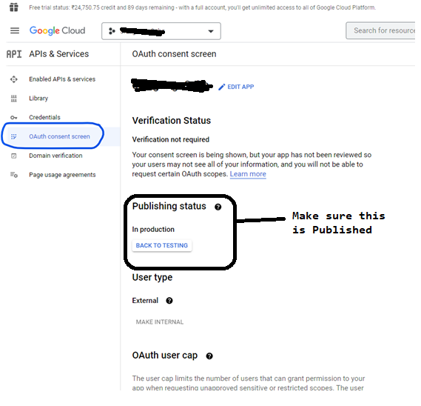
Step 5: Configure Oauth Consent Screen
Before you create credentials you will need to Configure the Oauth Consent Screen
After you configure, make sure you “Publish”. Only after this is the auth going to work from all Google IDs

Slide 10
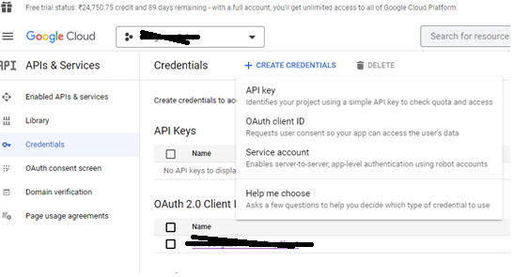
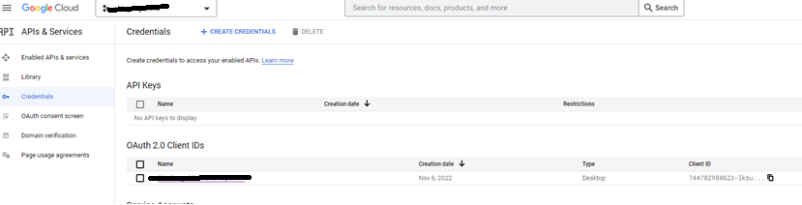
Step 6: Configure Oauth2.0 Credentials
Create Credentials -> Select “Oauth Client ID”
Select Application Type as “Desktop App”
Download the Credentials.json
Copy the credentials.json to .config folder
You will need to convert the credentials.json to a token.pickle file. You can do this using a simple python script (attached here)
The token.pickle file should be copied in .config folder
If you need help with this, contact mahendracc@hotmail.com

Slide 11
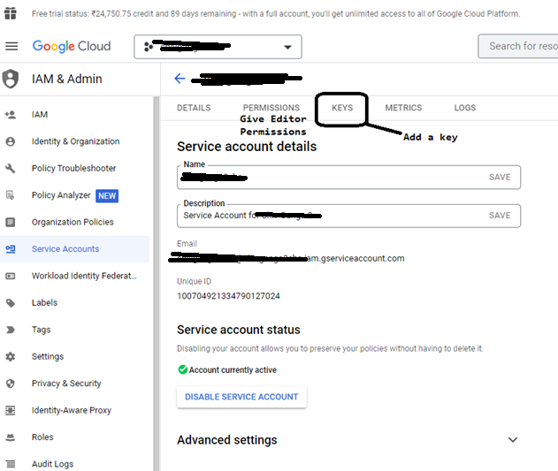
Step 7: Setup Service Account
For integrating with google sheets and restricting access only to the files we want to share, we are creating a service account
Create a New Service Account
Grant Role as Editor
Now go to keys and Add a key
Choose a JSON Key. It will also save a json file locally.
Rename the downloaded json file as service_account.json and copy it to the .config folder

Slide 12
Step 8: Create your Banner
Create your own Banner that should be displayed on the website
Save the file as Banner.png into the .banner folder (This name is currently hardcoded. Note that names are case sensitive)

Slide 13
Step 9: Docker Build
Ensure you have Docker installed (or install Docker Desktop for Windows)
Also, it would be good to setup WSL in case you have windows machine
Copy this Docker file into the folder you created in Step 3
Build the image and upload to Docker Hub. Run from the Folder you created in Step 3
docker build -t <nameofapp> .
docker tag <nameofapp>:latest <your docker hub id>/<nameofapp>:latest
sudo docker push <your docker hub id>/ <nameofapp>:latest

Slide 14
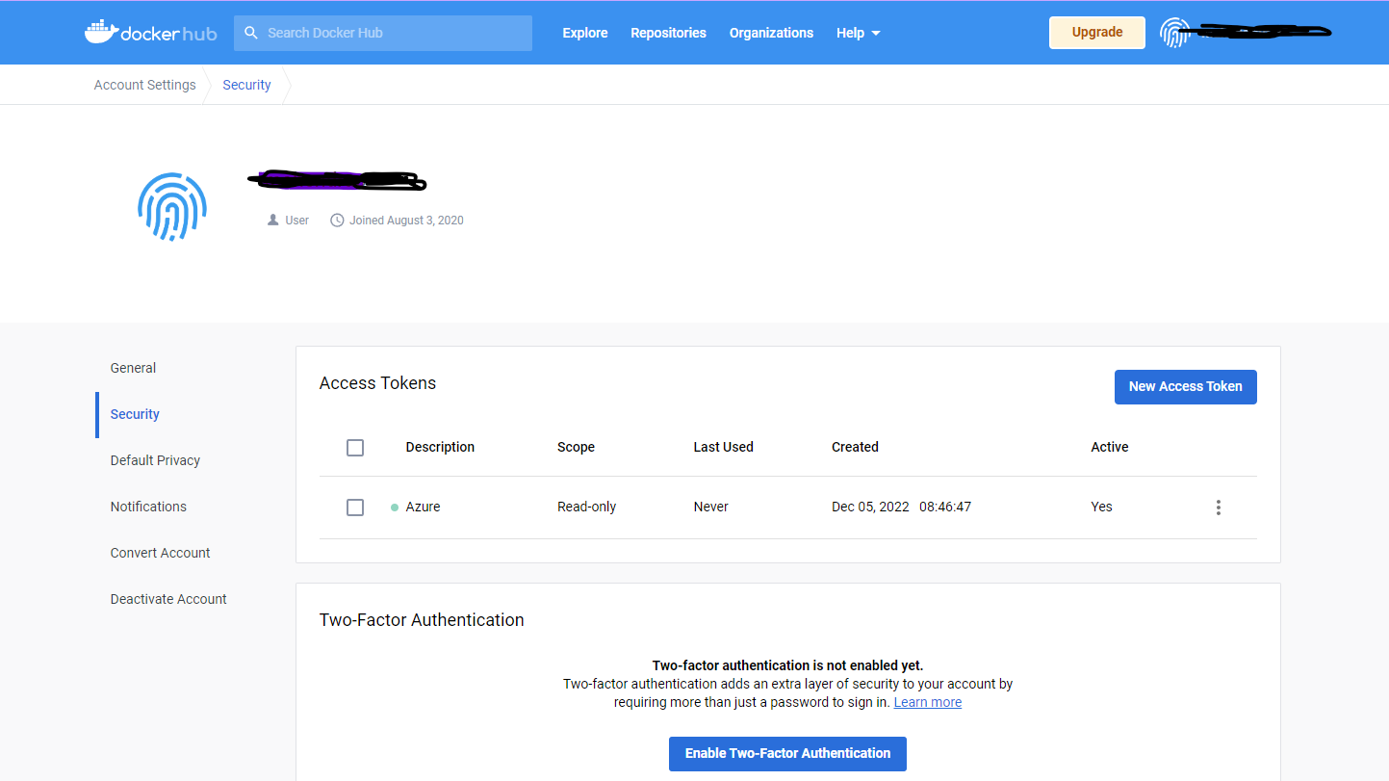
Step 10: Docker: Generate a access token
Generate an access token that you will use to authenticate in Azure
Copy the password

Slide 15
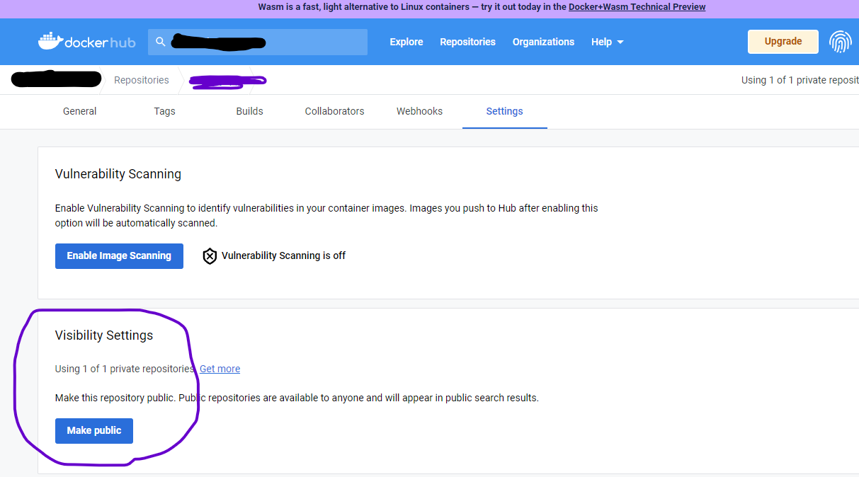
Step 11: Convert the image to Private
The free docker version allows one private repository

Slide 16
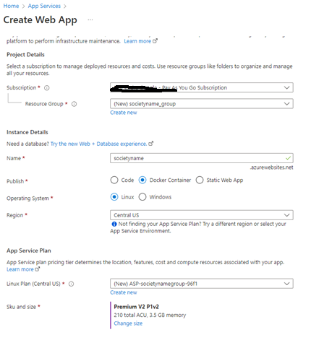
Step 12.1: Publish to Azure Web App
Create an Azure Web App (Choose an appropriate App Service Plan)
Select Publish as Docker Container

Slide 17
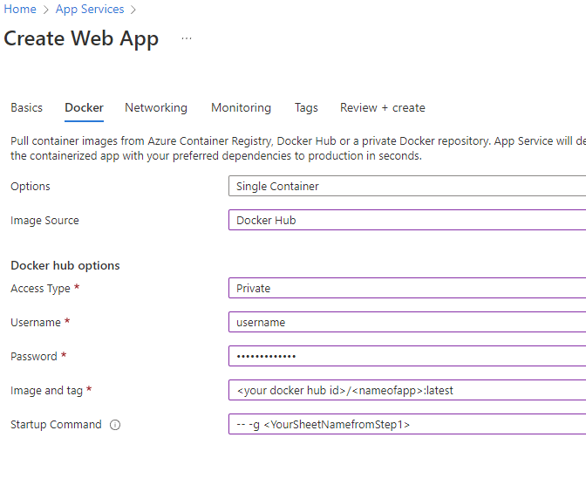
Step 12.2: Publish to Azure Web App
In the next tab, choose Image Source as “Docker Hub”, Access Type as Private
Give the user name and password of the token you generated in step 10
Image and Tag should be <your docker hub id>/ <nameofapp>:latest.
In the startup command give this command -- -g <YourSheetNamefromStep1>

Slide 18
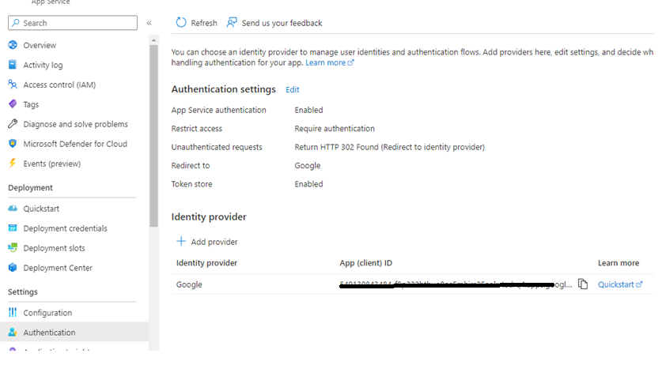
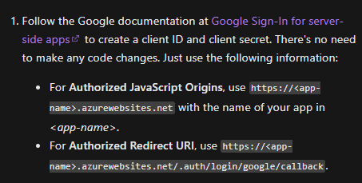
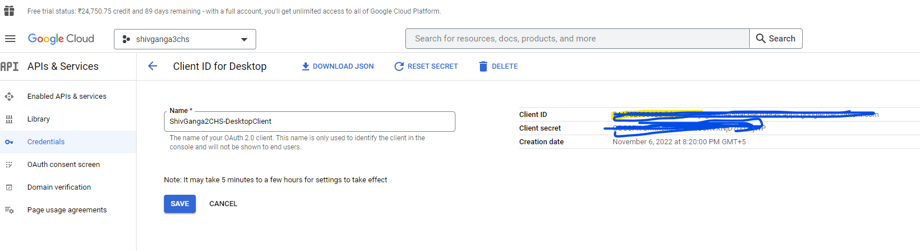
Step 13: Setup Login Authentication
In the App Service go to the Authentication tab and choose the identity provider as Google
Pick the Client ID and Secret from the “OAuth 2.0 Client IDs” that you created
Follow the other steps mentioned in https://learn.microsoft.com/en-us/azure/app-service/configure-authentication-provider-google

Slide 19
Step 14: Give access to the files
For all the files that you need to show in the app (where the Tab Type = GdriveDocument), you will need to give access to the files to the service account you created in Step 7.
If you don’t set this sharing up, then the documents will not be accessible. This will also allow you to restrict viewing to only the files you want and not the entire folder.
Additionally, please ensure you give editor access to the master gsheet (The file you created in Step1) to the service account.

Slide 20
Test the App
Complete: Now restart the web app and test it works as expected.

